Slide 1
DELE CA1 (CNN & RNN) Shaun Kwo 2317933 2A/03

Slide 2
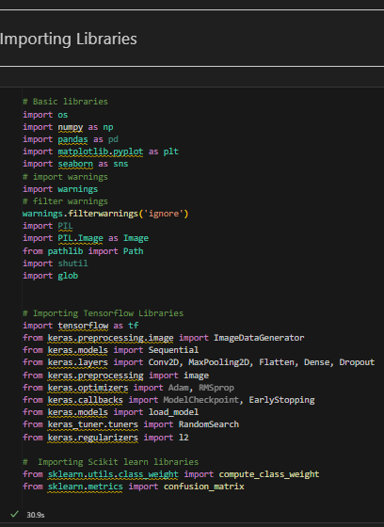
CNN Vegetable image classification
37x37
131x131

Slide 3
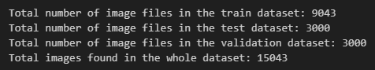
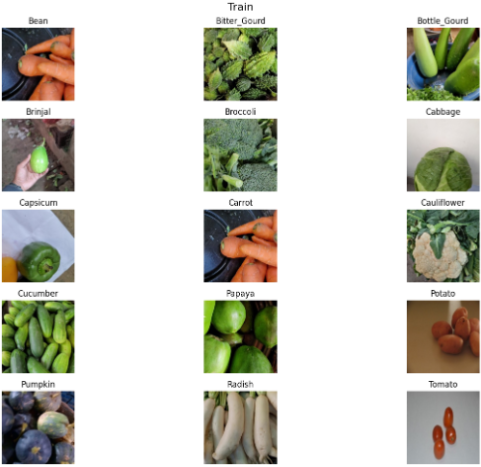
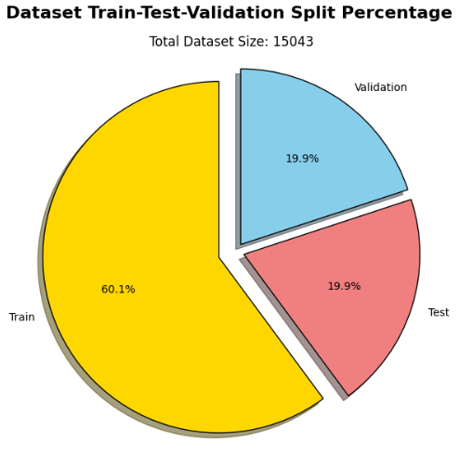
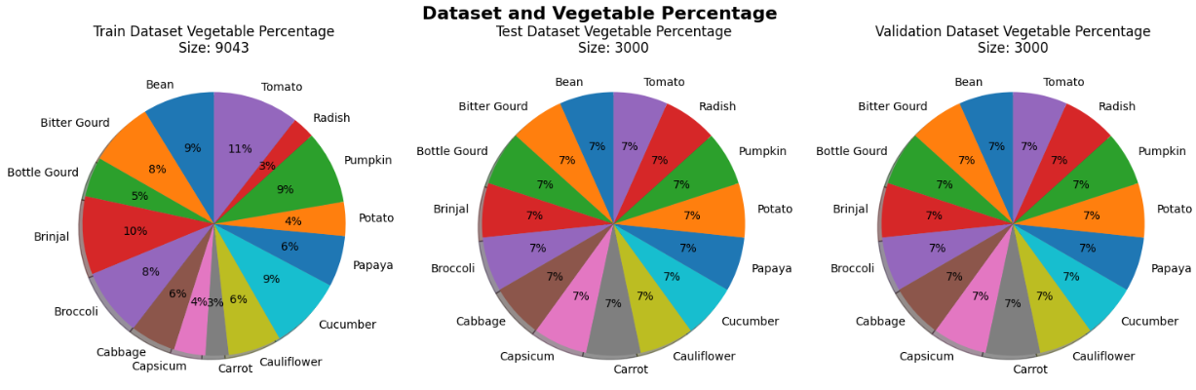
CNN Exploratory Data analysis (EDA)
Check file size of each file in Dataset for CA1 part A –AY2425S1/train or test or validation
Display first images from each dataset
Display percentage of train test validation in pie chart
Display percentage of each vegetable type in train test validation folders using a pie chart

Slide 4
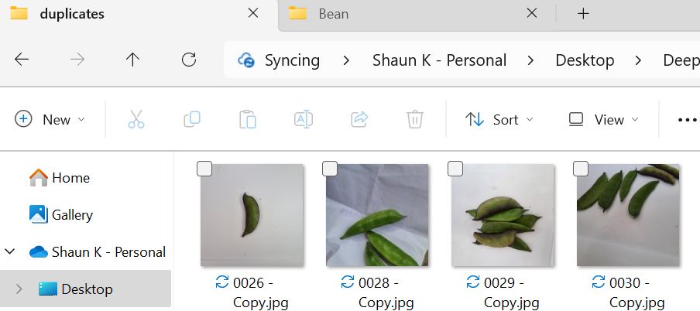
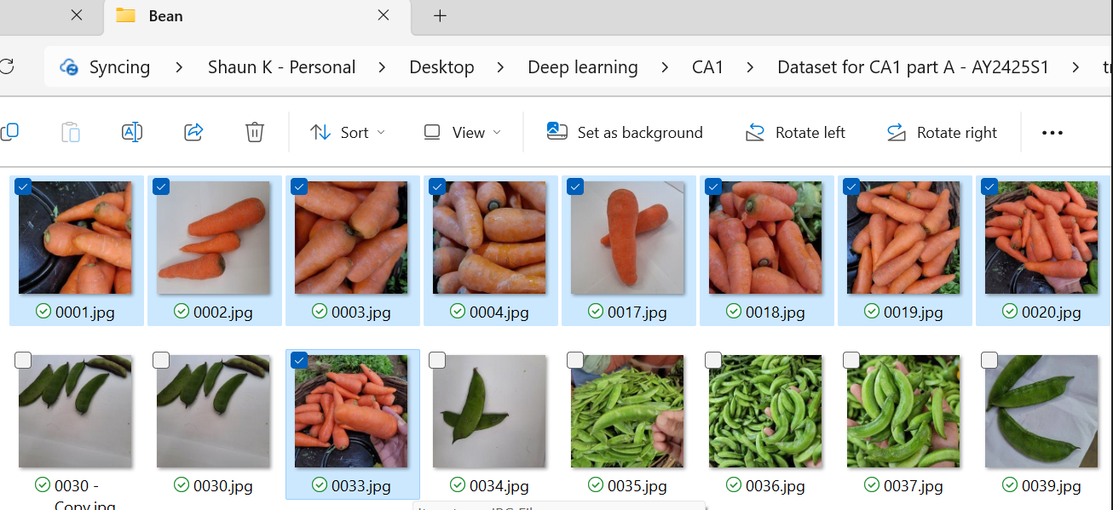
Feature engineering
Removing duplicated images from dataset and storing them in another folder called `duplicates`
Feature Engineering: Creating, modifying, or removing features in a dataset to improve machine learning model performance.
Removing Duplicates or Misplaced Data:
Redundancy Reduction: Eliminates unnecessary data, reducing computational overhead.
Data Quality Enhancement: Improves data quality, a critical aspect of feature engineering.
Model Performance: Cleaner data enhances the model's ability to learn and make accurate predictions.
Reduce Chance of Misclassification: Carrot images in `Bean` dataset will confuse the model
In `train`, `Bean dataset`, there are `Carrot images` so I will remove `Carrot` images from `Bean` dataset

Slide 5
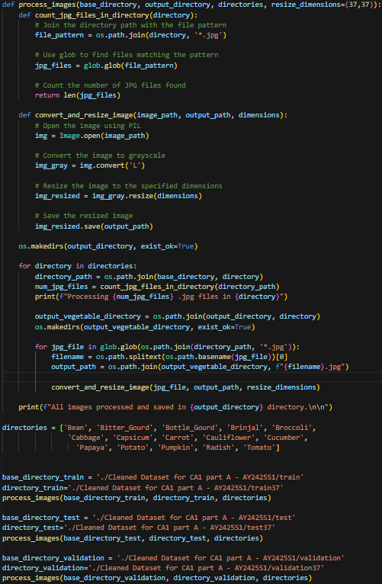
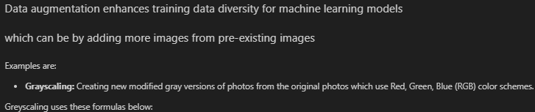

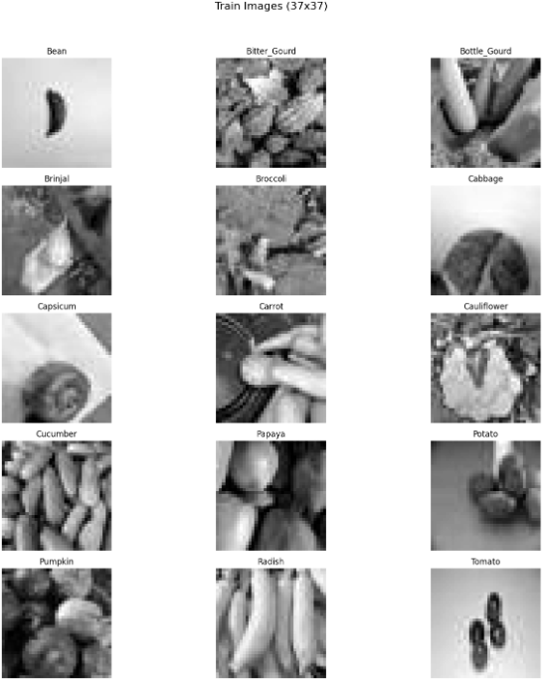
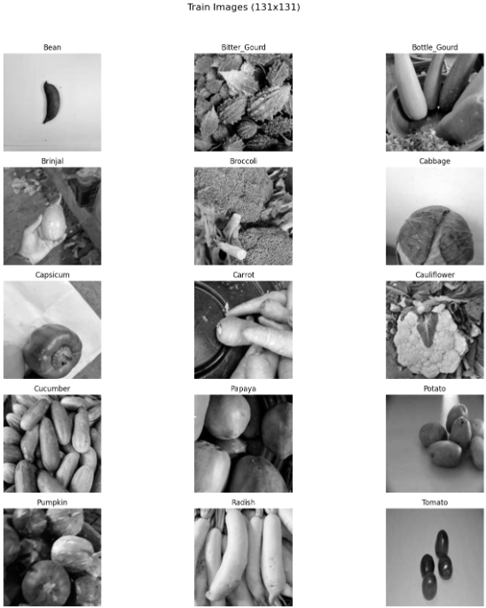
Data Augmentation

Slide 6
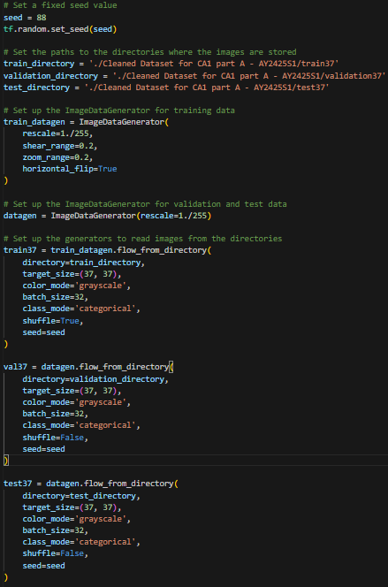
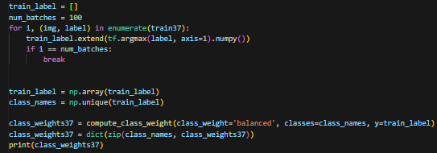
Further augmenting Data & weight balancing
Further augmentation can be done by shearing, zooming and flipping of images
Finding weight balance of datasets as weight balancing gives more importance (higher weights) to minority classes (smaller datasets) during model training.
Number of vegetable type or classes is 15 so

Slide 7
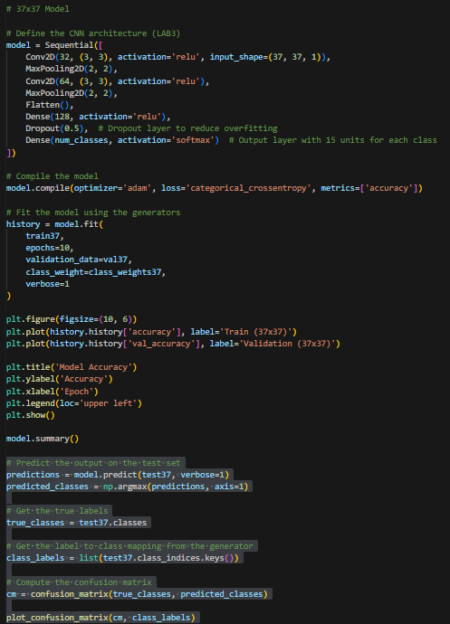
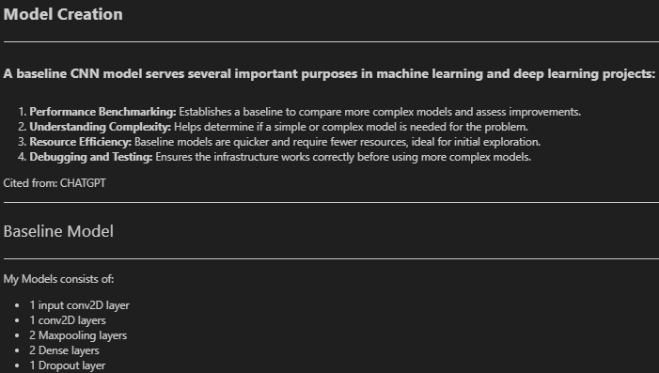
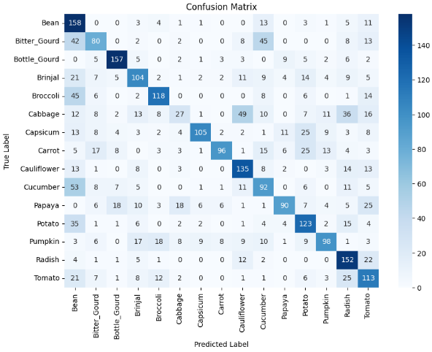
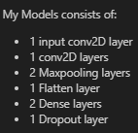
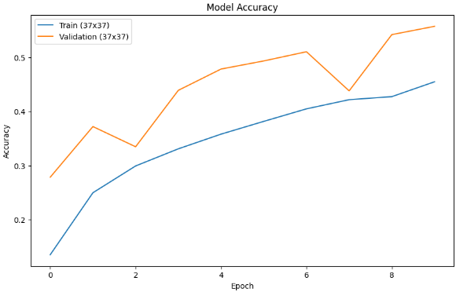

Slide 8
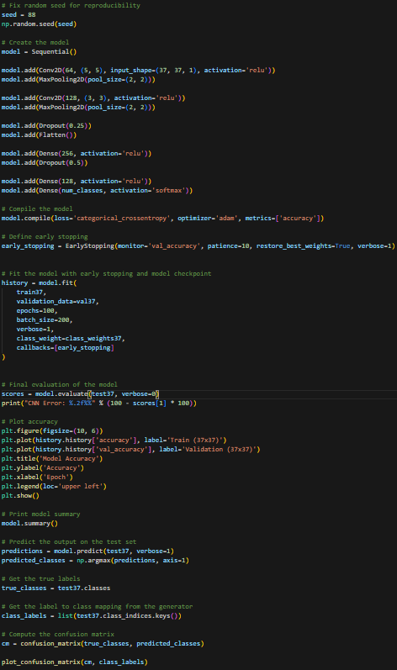
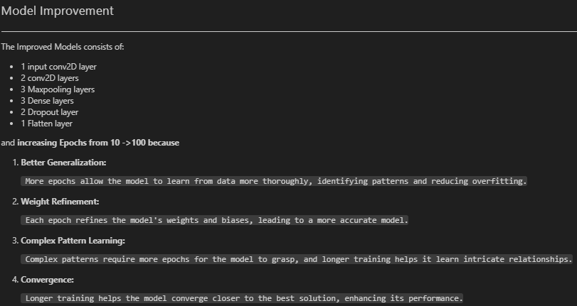
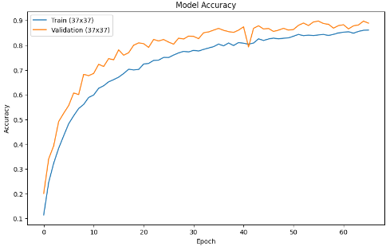
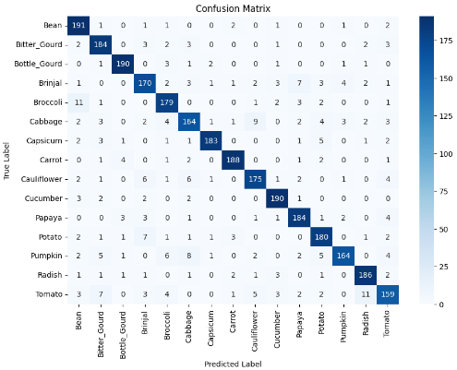
I have also realised that the 131x131 model has some underfitting whereby the validation accuracy > train accuracy, hence I would be trying L2 regularisation

Slide 9
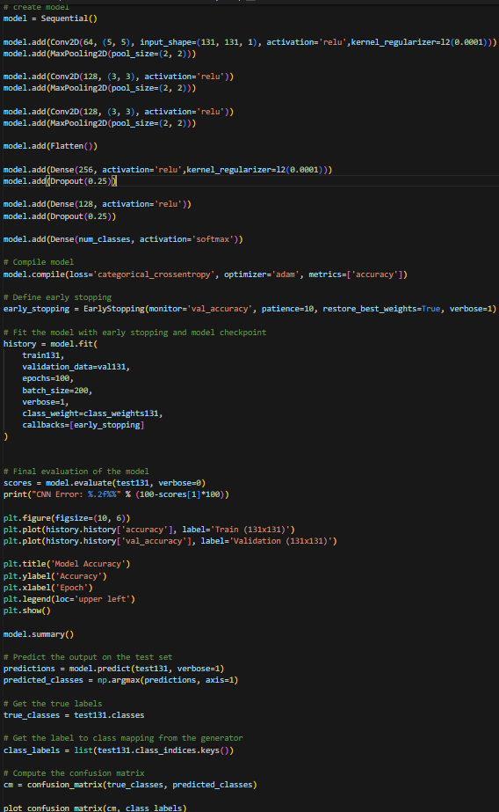
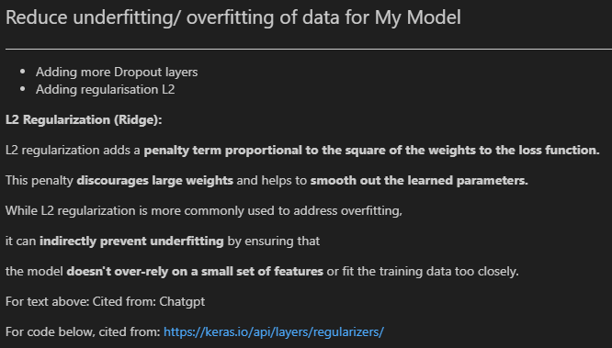
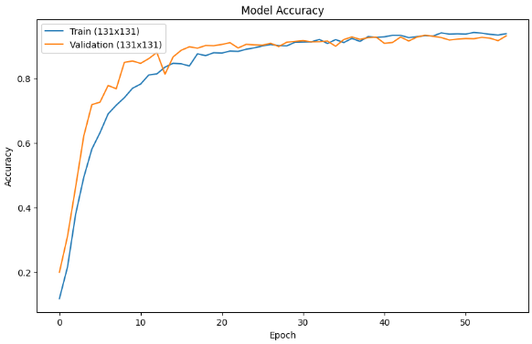
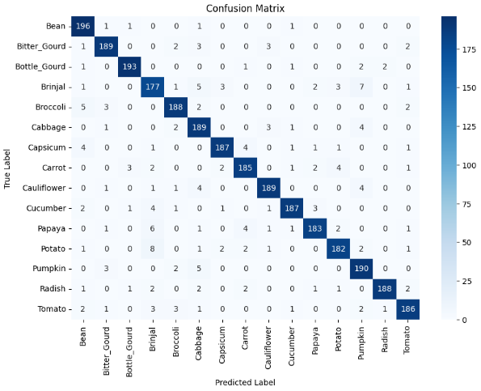

Slide 10
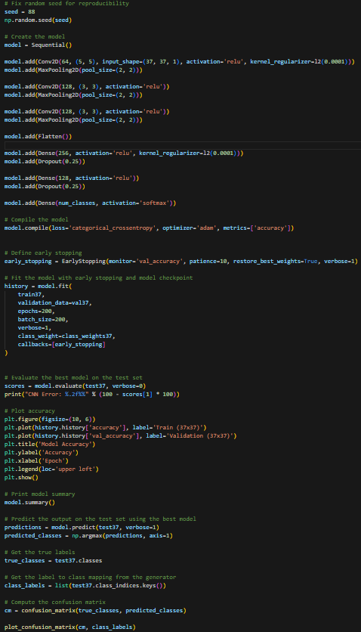
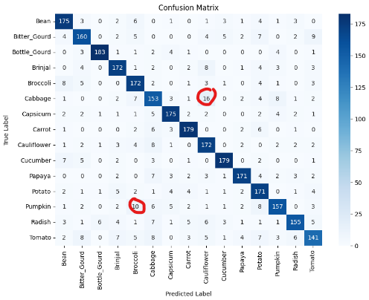
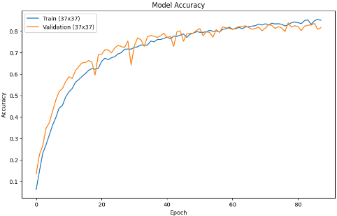
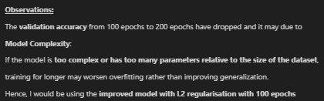
Increasing epochs from 100 to 200

Slide 11
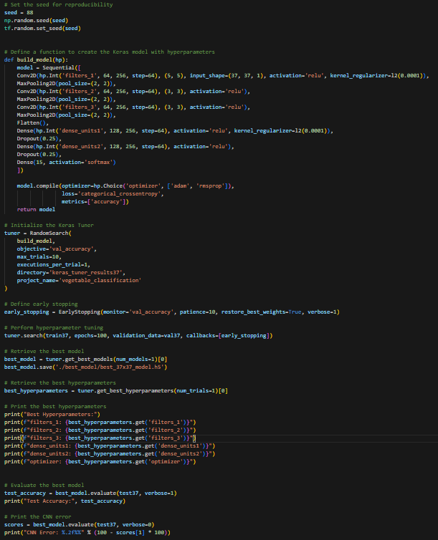
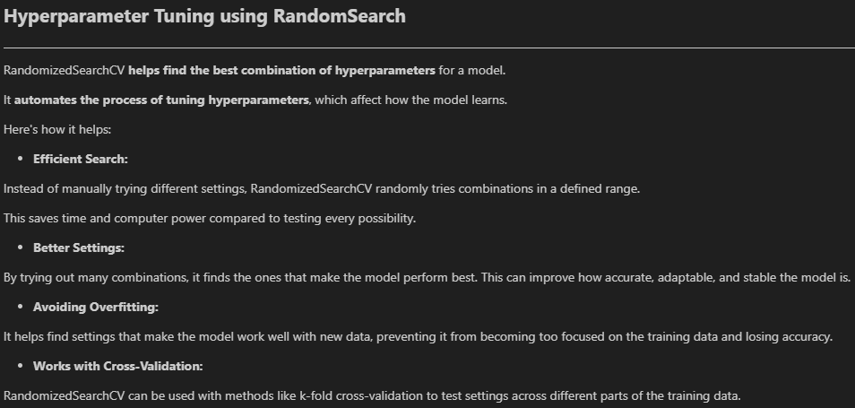
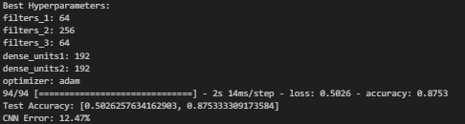
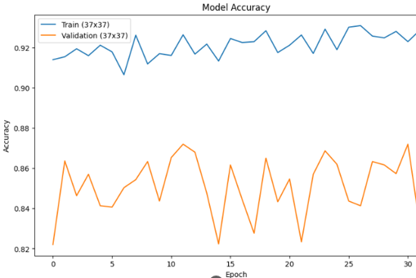
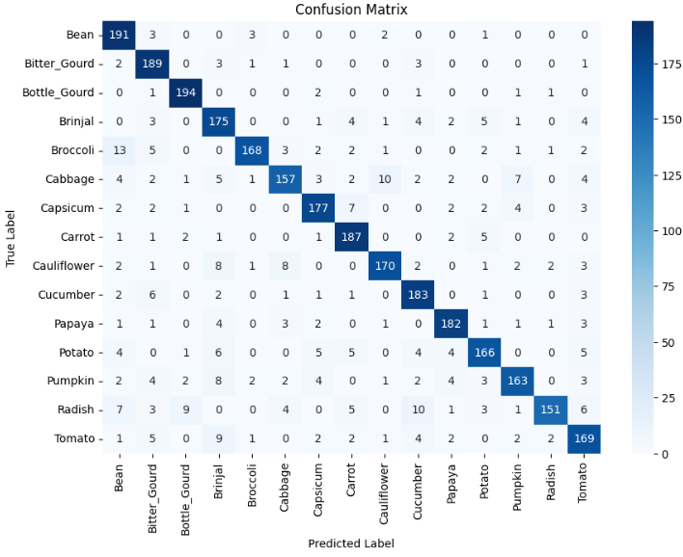

Slide 12
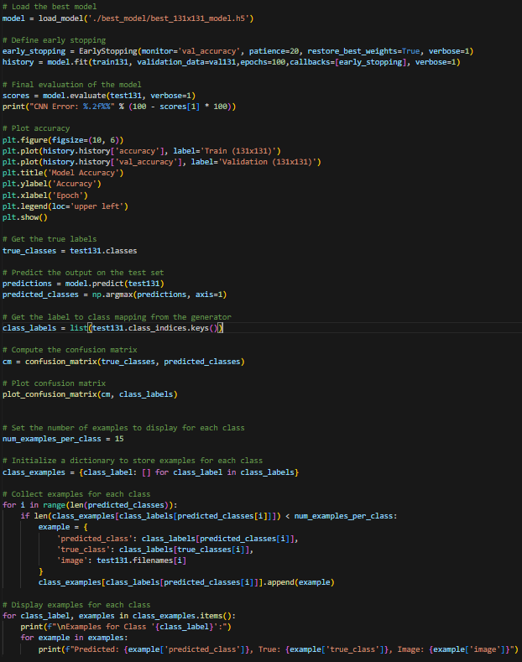
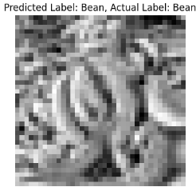
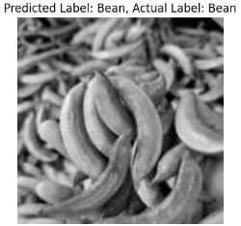
Testing the model and Its Predictions
In conclusion, CNNs are a key tool in image analysis, built to understand visuals like humans do. They learn features from images, simplify them, and make decisions, making them great for tasks like image classification and object detection. CNNs are vital in computer vision for their ability to process and interpret visual data efficiently.

Slide 13
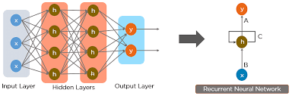
RNN
Movie Reviews
Sentiment Classification
Picture cited from: https://www.simplilearn.com/tutorials/deep-learning-tutorial/rnn

Slide 14
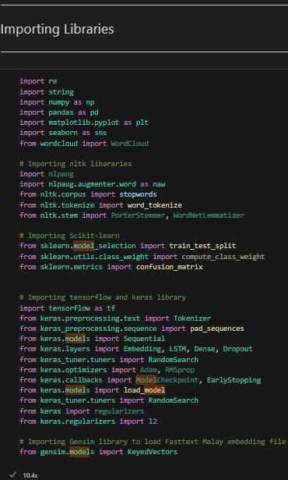
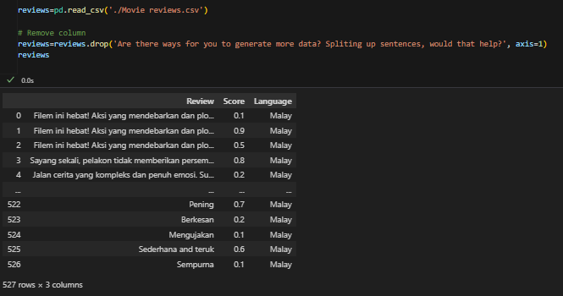
Loading python libraries
IMPORTING DATASET

Slide 15
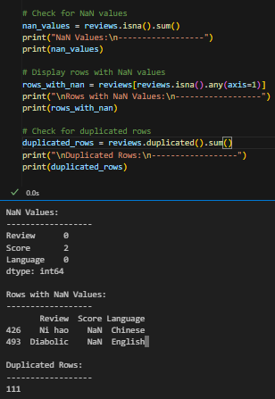
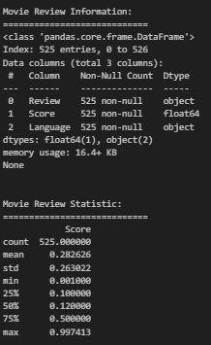
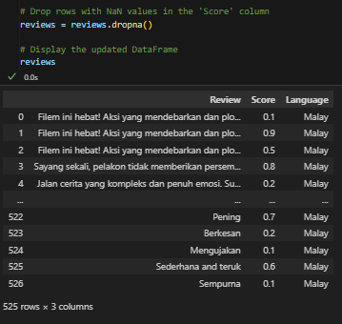
RNN Exploratory Data analysis
3. Dropping rows with missing score values as it will not be accurate to estimate scores.
4. NOT dropping duplicated rows as duplicated rows may affect statistical analyses, such as calculating means, variances, or correlations but assuming the movie reviews are natural occurrences in reviews written by different people.
Natural occurrence: Duplicates may highlight valuable information like recurring themes or popular opinions.
More data is better most of the time: Keeping duplicates can benefit model training and insights.
Check for Nan or missing values
Check for duplicated rows

Slide 16
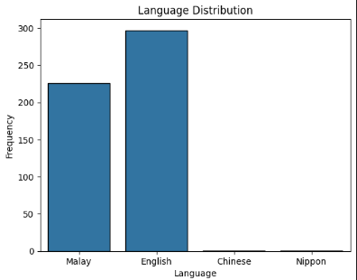
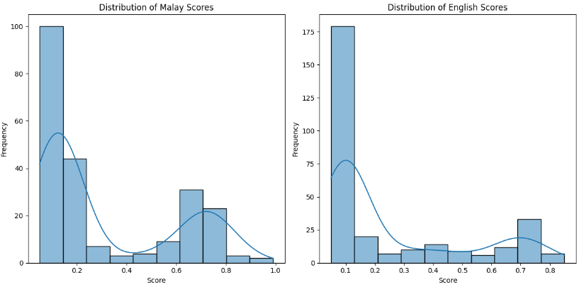
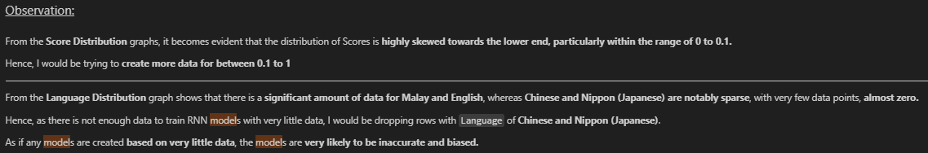
CHART Displays of Dataset

Slide 17
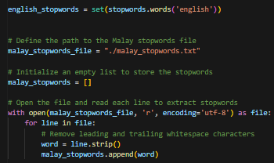
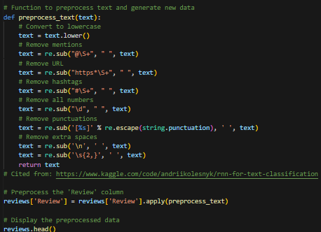
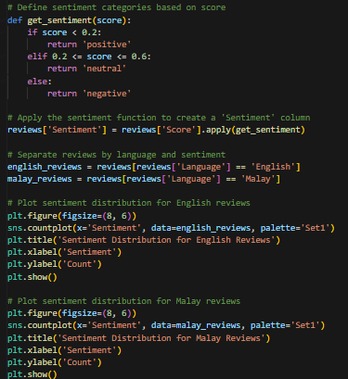


DATA PREPROCESSING
Loading stopwords: Malay and English
Preprocessing text: Changing all text to lowercase and removing symbols, URL links, punctuations and all the unnecessary things.
Splitting Sentiment by Score
As there seems to be a data inbalance in the sentiments, I would be oversampling to balance the sample size of them

Slide 18



Creating more data BY using NLPAUG (Synonyms)

Slide 19


FINDING MOST COMMON WORDS FOR EACH SENTIMENT USING WORDCLOUD
So, for example for English:
Positive word: visual effects
Neutral: avengers endgame
Negative: lack

Slide 20




Slide 21




Slide 22





Slide 23




Baseline Model

Slide 24



There has been a slight improvement to the model with increased EPOCHS with validation accuracy increasing from 87.5% to 93%

Slide 25




I added an extra LSTM layer to capture deeper patterns and a dropout layer to prevent overfitting, enhancing model complexity and generalization which actually benefitted the model
Val_acc went from 93 to 95%

Slide 26




Best hyperparameters

Slide 27


Loading and testing Hyperparameter tuned model
RNNs excel in sentiment analysis due to their ability to capture sequential patterns, contextual dependencies, and long-term dependencies in text data.
Cited from: Chatgpt

Slide 28

Thank you

